Slide 1
IIT Bombay
Page 1
Course Code : EE 611
Department: Electrical Engineering
Instructor Name: Jayanta Mukherjee
Email: jayanta@ee.iitb.ac.in
Lecture 13
EE 611 Lecture 13 Jayanta Mukherjee

Slide 2
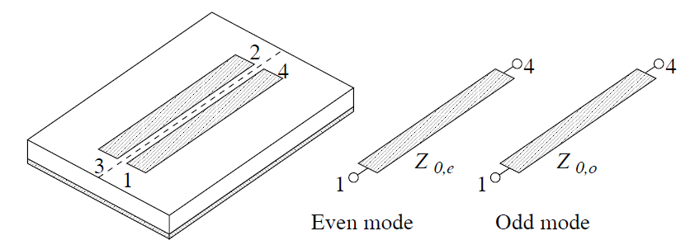
IIT Bombay
Page 2
Directional Couplers
EE 611 Lecture 10 Jayanta Mukherjee
EE 611 Lecture 12 Jayanta Mukherjee

Slide 3
IIT Bombay
Page 2
Even and Odd Mode Analysis
EE 611 Lecture 10 Jayanta Mukherjee
EE 611 Lecture 12 Jayanta Mukherjee

Slide 4
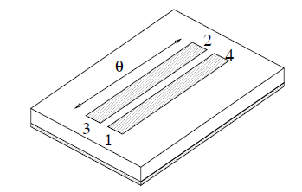
IIT Bombay
Page 2
Proof of Isolation
EE 611 Lecture 10 Jayanta Mukherjee
EE 611 Lecture 12 Jayanta Mukherjee

Slide 5
IIT Bombay
Page 2
Broadband Matching
EE 611 Lecture 10 Jayanta Mukherjee
EE 611 Lecture 12 Jayanta Mukherjee

Slide 6
IIT Bombay
Page 2
Coupled and Through Gains
EE 611 Lecture 10 Jayanta Mukherjee
EE 611 Lecture 12 Jayanta Mukherjee

Slide 7
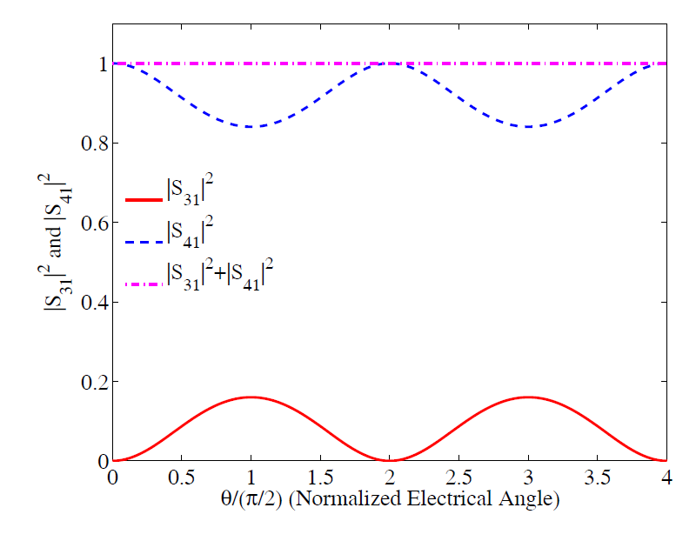
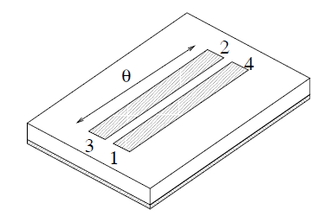
IIT Bombay
Page 2
Frequency Dependence of Coupling
Amd Through Gains
EE 611 Lecture 10 Jayanta Mukherjee
EE 611 Lecture 12 Jayanta Mukherjee

Slide 8
IIT Bombay
Page 2
Center Frequency Matrix
EE 611 Lecture 10 Jayanta Mukherjee
EE 611 Lecture 12 Jayanta Mukherjee

Slide 9
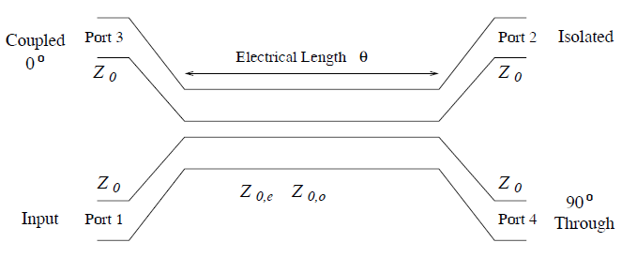
IIT Bombay
Page 2
Summary
EE 611 Lecture 10 Jayanta Mukherjee
EE 611 Lecture 12 Jayanta Mukherjee

Slide 10
IIT Bombay
Page 2
Multisection Devices
EE 611 Lecture 10 Jayanta Mukherjee
EE 611 Lecture 12 Jayanta Mukherjee

Slide 11
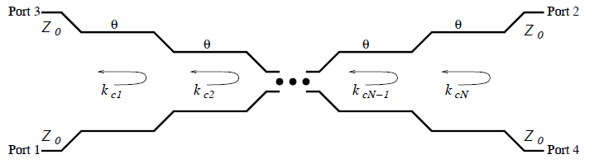
IIT Bombay
Page 2
Multisection Device Coupling
EE 611 Lecture 10 Jayanta Mukherjee
EE 611 Lecture 12 Jayanta Mukherjee

Slide 12
IIT Bombay
Page 2
Multisection Device Coupling
EE 611 Lecture 10 Jayanta Mukherjee
EE 611 Lecture 12 Jayanta Mukherjee

Slide 13
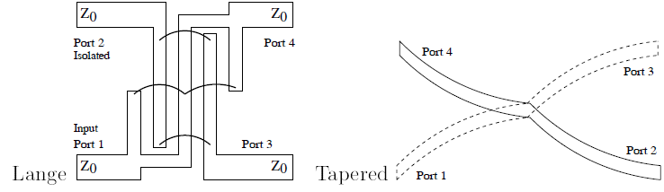
IIT Bombay
Page 2
Other Couplers
EE 611 Lecture 10 Jayanta Mukherjee
EE 611 Lecture 12 Jayanta Mukherjee

Slide 14
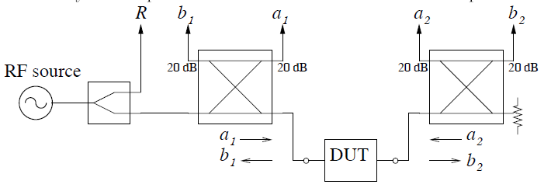
IIT Bombay
Page 2
Network Analyzer Test Set
EE 611 Lecture 10 Jayanta Mukherjee
EE 611 Lecture 12 Jayanta Mukherjee

Slide 15
IIT Bombay
Page 2
Network Analyzer Test Set
EE 611 Lecture 10 Jayanta Mukherjee
EE 611 Lecture 12 Jayanta Mukherjee

Slide 16
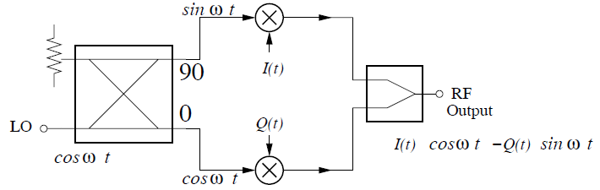
IIT Bombay
Page 2
IQ Modulators
EE 611 Lecture 10 Jayanta Mukherjee
EE 611 Lecture 12 Jayanta Mukherjee

Slide 17
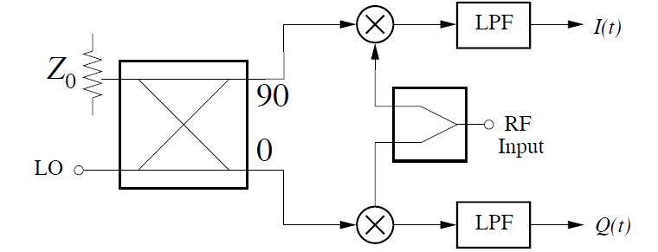
IIT Bombay
Page 2
IQ Demodulators
EE 611 Lecture 10 Jayanta Mukherjee
EE 611 Lecture 12 Jayanta Mukherjee

Slide 18
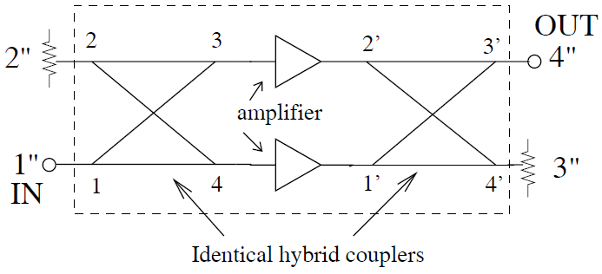
IIT Bombay
Page 2
Balanced Amplifiers
EE 611 Lecture 10 Jayanta Mukherjee
EE 611 Lecture 12 Jayanta Mukherjee

Slide 19
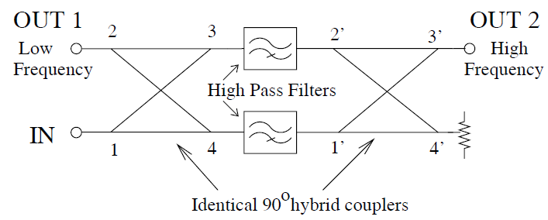
IIT Bombay
Page 2
Balanced Filters
EE 611 Lecture 10 Jayanta Mukherjee
EE 611 Lecture 12 Jayanta Mukherjee

Slide 20
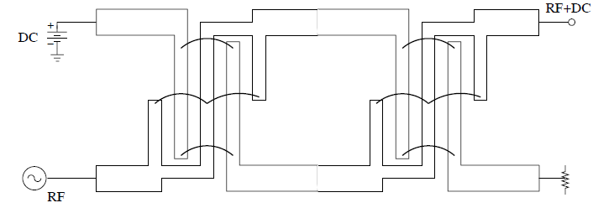
IIT Bombay
Page 2
Bias Tee
EE 611 Lecture 10 Jayanta Mukherjee
EE 611 Lecture 12 Jayanta Mukherjee

